Slide 2
Data Presentation
Past Pricing Information
Extra Technical Measures
Sentiment data for the market
Blockchain Information
Outside Factors
Engineering Features
Goal Variable
Sets for Training and Testing

Slide 3
Data Cleaning
Managing Missing Values
Eliminating Duplicates
Managing Outliers
Changing Data Types
Managing Deviations
Normalization and Scaling
Managing Time Zone Problems
Establishing Lag Features

Slide 4
Methods
Averages that Move:
Price data may be smoothed and patterns can be found by using the Simple Moving Average (SMA) and Exponential Moving Average (EMA).
Analysis of Time Series:
When performing time series analysis using Pandas, you may investigate patterns, autocorrelation, and seasonality in the historical data.

Slide 5
Models for Machine Learning:
Make use of machine learning methods such as support vector machines, decision trees, random forests, and linear regression. For feature engineering and model training, you may combine Pandas with libraries like scikit-learn.
Models for Deep Learning:
Complex patterns in time series data can be captured by neural networks, especially recurrent neural networks (RNNs) or long short-term memory networks (LSTMs). Models of this kind may be created and trained using PyTorch or TensorFlow.

Slide 6
Approach
Step 1: Gathering Information:
Obtain historical pricing information on cryptocurrencies from reputable sites or APIs. To get data, you can use libraries like cryptocompare or ccxt
Step 2: Preparing the data:
If required, handle missing values, carry out feature engineering, and normalize the data.

Slide 7
Step 3: Choosing Features:
Select pertinent features for forecasting. Technical indicators, trade volume, and historical prices are common aspects.
Step 4: Split the train and test:
Divide the data into sets for testing and training.
Step 5: Constructing Models:
Utilizing the training set of data, select a prediction model and train it.

Slide 8
Step 6: Illustration:
Compare the projected and real pricing visually.
Step 7: Optimization and Fine-Tuning:
To maximize performance, try out various models, features, and hyperparameters.
Step 8: Optional Deployment:
If it's necessary, deploy the model using frameworks like Flask or FastAPI for real-time predictions.

Slide 9
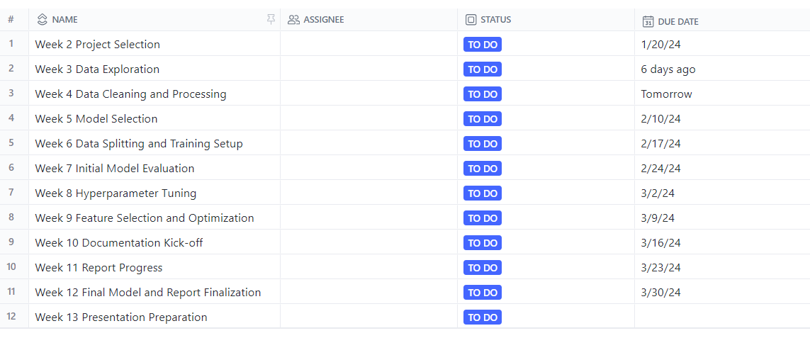
Time Line

Slide 10
Questionnaire?

